Slide 1






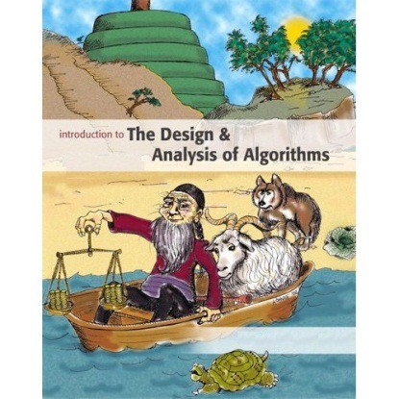



Introduction to
Algorithm Design and Analysis
[2] Asymptotics
Yu Huang
http://cs.nju.edu.cn/yuhuang Institute of Computer Software Nanjing University

Slide 2

In the Last Class…
Algorithm – the spirit of computing
Model of computation
Algorithm design and analysis
Design
Correctness proof by induction
Analysis
Worst-case / average-case complexity

Slide 3

Asymptotic Behavior
Asymptotic growth rate of functions
Basic idea
Key notations
o 𝑂𝑂, Ω, Θ
o 𝑜𝑜, 𝜔𝜔
Brute force enumeration
By iteration
By recursion

Slide 4


How to Compare Two Algorithms
Algorithm analysis, with simplifications
Measuring the cost by the number of critical operations
Large input size only
Only the leading term in 𝑓𝑓(𝑛𝑛) is considered
Constant coefficients are ignored
Capturing the essential part in the cost in a mathematical way
Asymptotic growth rate of 𝑓𝑓(𝑛𝑛)

Slide 5

Relative Growth Rate
Ω(g):functions that grow at least as fast as g
Θ(g):functions that grow at the same rate as g
g
Ο(g):functions that grow no faster as g

Slide 6
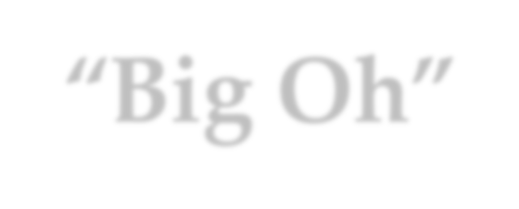
“Big Oh”
Basic idea 𝑓𝑓(𝑛𝑛) ∈ 𝑂𝑂 𝑔𝑔(𝑛𝑛)
For sufficiently large input size, g(n) is an upper bound for f(n)
Definition – “𝛆𝛆 − 𝑵𝑵”
Giving g: N→R⁺, then Ο(g) is the set of f:N→R⁺, such that for some c∈R⁺ and some n₀∈N, f(n)≤cg(n) for all n≥n₀
Definition – “𝒍𝒍𝒍𝒍𝒍𝒍_{𝒏𝒏→∞}”
o 𝑓𝑓 ∈ 𝑂𝑂 𝑔𝑔 if lim ^{𝑓𝑓(𝑛𝑛)} = 𝑐𝑐 < ∞
𝑛𝑛→∞ 𝑔𝑔(𝑛𝑛)

Slide 7





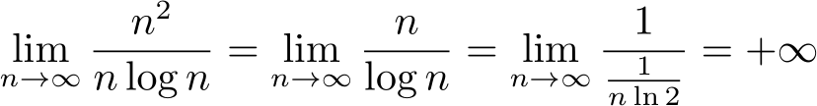

Example
Let f(n)=n², g(n)=nlogn, then:
o f∉Ο(g), since
L’Hospital’s rule
o g∈Ο(f), since

Slide 8


Asymptotic Growth Rate
_{nk 2}n
nlogn
n
log n

Slide 9

Asymptotic Order
Logarithm log n
logn ∈ O(n^{α}) for any α>0
Power n^{k}
_{n}k
∈ O(c^{n}) for any c>1
Factorial n!
𝒏𝒏! ≈
𝒏𝒏 _{𝒏𝒏}
𝟐𝟐𝝅𝝅𝒏𝒏( )
(Stirling’s formula)
𝒆𝒆

Slide 10



“Big Ω”
Basic idea of 𝑓𝑓(𝑛𝑛) ∈ Ω 𝑔𝑔(𝑛𝑛)
Dual of “O”
Definition – “𝛆𝛆 − 𝑵𝑵”
Giving g: N→R⁺, then Ω(g) is the set of f:N→R⁺, such that for some c∈R⁺ and some n₀∈N, f(n)≥cg(n) for all n≥n₀
Definition – “𝒍𝒍𝒍𝒍𝒍𝒍_{𝒏𝒏→∞}”
o 𝑓𝑓 ∈ Ω 𝑔𝑔 if lim ^{𝑓𝑓(𝑛𝑛)} = 𝑐𝑐 > 0 (the limit may be ∞)
𝑛𝑛→∞ 𝑔𝑔(𝑛𝑛)

Slide 11


The Set Θ
Basic idea of 𝑓𝑓(𝑛𝑛) ∈ Θ 𝑔𝑔(𝑛𝑛)
Roughly the same
o Θ 𝑔𝑔 = 𝑂𝑂(𝑔𝑔) ∩ Ω(𝑔𝑔)
Definition – “𝛆𝛆 − 𝑵𝑵”
Giving g:N→R⁺, then Θ 𝑔𝑔 is the set of f:N→R⁺, such that for some c₁,c₂∈R⁺ and some n₀∈N,
0 ≤ 𝑐𝑐₁𝑔𝑔(𝑛𝑛) ≤ 𝑓𝑓(𝑛𝑛) ≤ 𝑐𝑐₂𝑔𝑔(𝑛𝑛), for all 𝑛𝑛 ≥ 𝑛𝑛₀
Definition – “𝒍𝒍𝒍𝒍𝒍𝒍_{𝒏𝒏→∞}”
o 𝑓𝑓 ∈ Θ 𝑔𝑔 if lim ^{𝑓𝑓(𝑛𝑛)} = 𝑐𝑐 (0 < 𝑐𝑐 < ∞)
𝑛𝑛→∞ 𝑔𝑔(𝑛𝑛)

Slide 12
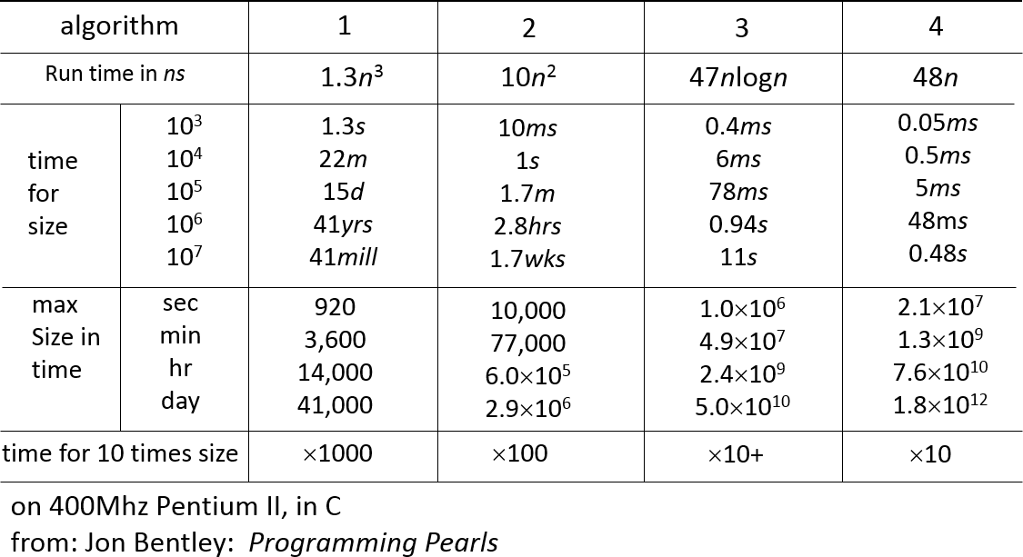
Some Empirical Data

Slide 13




Properties of O, Ω and Θ
Transitive property:
If f∈O(g) and g∈O(h), then f∈O(h)
Symmetric properties
f∈O(g) if and only if g∈Ω(f)
o f∈Θ(g) if and only if g∈Θ(f)
Order of sum function
O(f+g)=O(max(f,g))

Slide 14
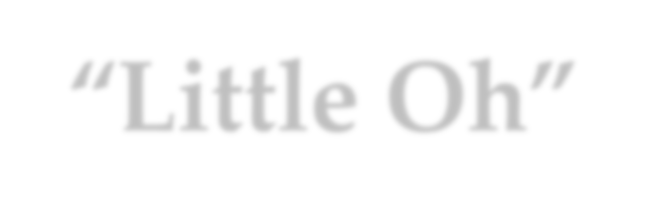
“Little Oh”
Basic idea of 𝑓𝑓(𝑛𝑛) ∈ 𝑜𝑜 𝑔𝑔(𝑛𝑛)
Non-ignorable gap between f and its upper bound g
Definition –“𝛆𝛆 − 𝑵𝑵”
Giving g:N→R⁺, then o(g) is the set of f:N→R⁺, such that for any c∈R⁺ , there exists some n₀∈N,
0 ≤ 𝑓𝑓 𝑛𝑛 < 𝑐𝑐𝑔𝑔(𝑛𝑛), for all 𝑛𝑛 ≥ 𝑛𝑛₀
Definition – “𝒍𝒍𝒍𝒍𝒍𝒍_{𝒏𝒏→∞}”
o 𝑓𝑓 ∈ 𝑜𝑜 𝑔𝑔 if lim ^{𝑓𝑓(𝑛𝑛)} = 0
𝑛𝑛→∞ 𝑔𝑔(𝑛𝑛)

Slide 15


“Little ω”
Basic idea of 𝑓𝑓(𝑛𝑛) ∈ 𝜔𝜔 𝑔𝑔(𝑛𝑛)
Dual of “o”
Definition – “𝛆𝛆 − 𝑵𝑵”
Giving g:N→R⁺, then ω(g) is the set of f:N→R⁺, such that for any c∈R⁺ , there exists some n₀∈N,
0 ≤ 𝑐𝑐𝑔𝑔 𝑛𝑛 < 𝑓𝑓 𝑛𝑛 , for all 𝑛𝑛 ≥ 𝑛𝑛₀
Definition – “𝒍𝒍𝒍𝒍𝒍𝒍_{𝒏𝒏→∞}”
o 𝑓𝑓 ∈ 𝜔𝜔 𝑔𝑔 if lim ^{𝑓𝑓(𝑛𝑛)} = ∞
𝑛𝑛→∞ 𝑔𝑔(𝑛𝑛)

Slide 16

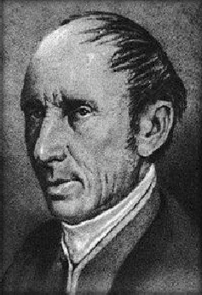
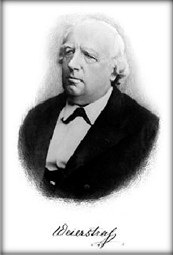
Do you know Infinity
Mathematical analysis
(Differentiation / integration)
o Early years
o Firm foundation
of mathematical analysis
Cauchy
How to talk about infinity?
(𝜺𝜺 − 𝑵𝑵)-definition
(𝜺𝜺 − 𝜹𝜹)-definition
Weierstrass

Slide 17


Brute Force Enumeration by Iteration
Swapping array elements
<time, space>
From <O(n²), O(1)>
To <O(n), O(n)>
To <O(n), O(1)>
Maximum subsequence sum
Time
From O(n³)
To O(n²)
To O(n log n)
To O(n)

Slide 18






Swapping Array Elements
E.g., 1,2,3,4 | 5,6,7 => 5,6,7,1,2,3,4
Brute force
Space sensitive
 | Time | Space
BF1 | O(n²) | O(1)
BF2 | O(n) | O(n)
Your Task | O(n) | O(1)
Your task
o Both time and space efficient
Time sensitive

Slide 19




Max-sum Subsequence
The problem: Given a sequence S of integer, find the largest sum of a consecutive subsequence of S. (0, if all negative items)
o An example: -2, 11, -4, 13, -5, -2; the result 20: (11, -4, 13)
A brute-force algorithm: MaxSum = 0;
for (i = 0; i < N; i++) for (j = i; j < N; j++)
{
ThisSum = 0;
for (k = i; k <= j; k++)
ThisSum += A[k];
if (ThisSum > MaxSum) MaxSum = ThisSum;
}
return MaxSum;
j=0
j=2
the sequence
j=1
j=n-1
i=0
i=1
k
i=2
……
i=n-1
in O(n³)

Slide 20


More Precise Complexity
n−1 n−1 j
The total cost is : ∑∑∑1
i =0 j =i k =i
∑1 = j − i +1
k =i
j
∑ ( j − i +1) = 1 + 2 + ... + (n − i) = ^{(n − i +1)(n − i)}
n−1
2
j =i
∑ (n − i +1)(n − i) _{= ∑} (n − i + 2)(n − i +1)
n−1 n
2 2
i =0 i =1
n
₌ 1 ∑
_{i} 2
n n
− (n + ³ )∑i + ¹ (n² + 3n + 2)∑1
2
₌ n + 3n + 2n
3 2
2 2
i =1
i =1 i =1
6

Slide 21




Decreasing the number of loops
An improved algorithm MaxSum = 0;
for (i = 0; i < N; i++)
{
ThisSum = 0;
for (j = i; j < N; j++)
{
ThisSum += A[j];
if (ThisSum > MaxSum) MaxSum = ThisSum;
}
}
return MaxSum;
the sequence
i=0
i=1
i=2
j
in O(n²)
i=n-1

Slide 22


Power of Divide and Conquer
Part 1
Part 2
the sub with largest sum may be in:
recursion
Part 1
Part 2
or:
The largest is the result
Part 1
Part 2
in O(nlogn)

Slide 23



Power of Divide and Conquer
Center = (Left + Right) / 2;
MaxLeftSum = MaxSubSum(A, Left, Center); MaxRightSum = MaxSubSum(A, Center + 1, Right);
MaxLeftBorderSum = 0; LeftBorderSum = 0; for (i = Center; i >= Left; i--)
{
LeftBorderSum += A[i];
if (LeftBorderSum > MaxLeftBorderSum)
}
MaxLeftBorderSum = LeftBorderSum;
Note: this is the core part of the procedure, with base case and wrap omitted.
MaxRightBorderSum = 0; RightBorderSum = 0; for (i = Center + 1; i <= Right; i++)
{
RightBorderSum += A[i];
if (RightBorderSum > MaxRightBorderSum) MaxRightBorderSum = RightBorderSum;
}
return Max3(MaxLeftSum, MaxRightSum, MaxLeftBorderSum + MaxRightBorderSum);

Slide 24




A Linear Algorithm
First scan the array to eliminate the case of “all negative integers”
ThisSum = MaxSum = 0;
for (j = 0; j < N; j++)
{
ThisSum += A[j];
if (ThisSum > MaxSum) MaxSum = ThisSum; else if (ThisSum < 0) ThisSum = 0;
}
return MaxSum;
the sequence
j
This is an example of “online algorithm”
Negative item or subsequence cannot be a prefix of the subsequence we want.
in O(n)

Slide 25

Brute Force Enumeration by Recursion
Job scheduling
Problem definition
Brute force recursion
Further improvements
Matrix chain multiplication
Problem definition
Brute force recursion(s)
Further improvements

Slide 26

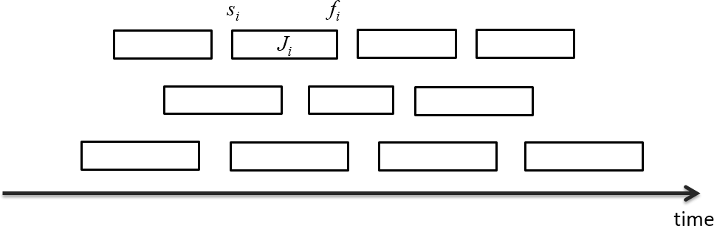
Job Scheduling
Jobs: J_{i}=[s_{i}, j_{i})
Max number of compatible jobs
Further improvements
Dynamic programming (L16)
Greedy algorithms (L14)

Slide 27


Matrix Chain Multiplication
The task:
Find the product: A₁×A₂×…×A_{n-1}×A_{n}
A_{i} is 2-dimentional array of different legal size
The Challenge:
Matrix multiplication is associative
Different computing order results in great difference in the number of operations
The problem:
Which is the best computing order
Lectures on Algorithm Design & Analysis (LADA), 2015
2015/3/4

Slide 28





Cost of Matrix Multiplication
An example: A₁ × A₂ × A₃ × A₄ 30×1 1×40 40×10 10×25
((A₁×A₂)×A₃)×A₄: | 20700 multiplications
A₁×(A₂×(A₃×A₄)): | 11750
(A₁×A₂)×(A₃×A₄): | 41200
A₁×((A₂×A₃)×A₄): | 1400
Let C = A_{p×q}×
^{B}q⋅r
q
^{c}i, j ⁼∑ªik ^{b}kj
k =1
There are q multiplication
C has p×r elements as c_{i,j}
So, pqr multiplications altogether
Lectures on Algorithm Design & Analysis (LADA), 2015
2015/3/4

Slide 29

Solutions
Brute force recursion (L16)
BF1
BF2
Dynamic programming (L16)
Based on brute force recursion 2

Slide 30




Thank you!
Q & A
Yu Huang yuhuang@nju.edu.cn http://cs.nju.edu.cn/yuhuang

